Slide 1
DAY 08 Lab 3
8.8, 9.8* and 9.9
1

Slide 2
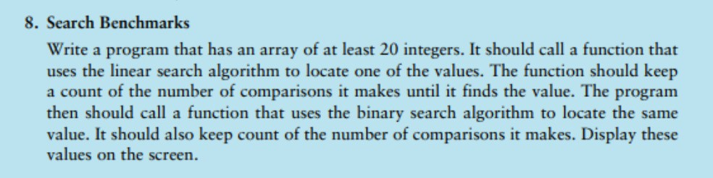

Slide 3
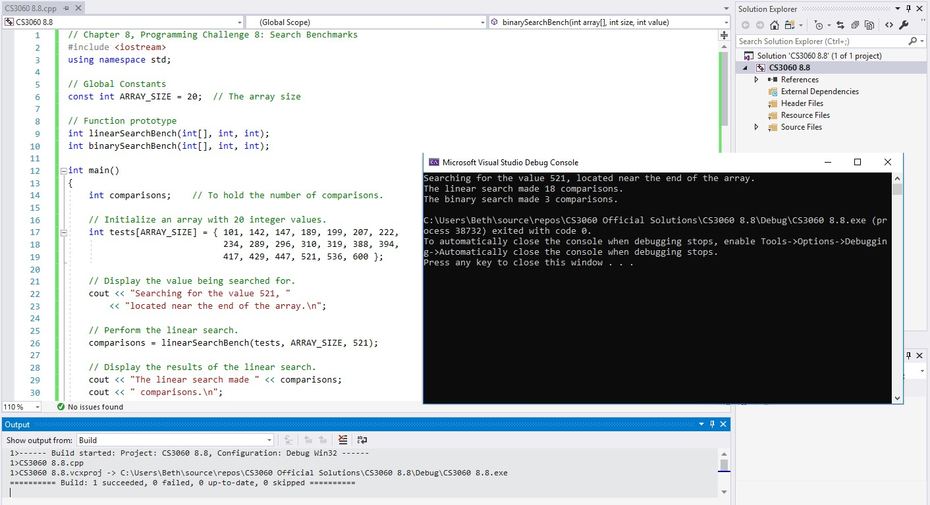

Slide 4
// Chapter 8, Programming Challenge 8: Search Benchmarks
#include <iostream>
using namespace std;
// Global Constants
****
// Function prototype
****
int main()
{
}

Slide 5
// Chapter 8, Programming Challenge 8: Search Benchmarks #include <iostream>
using namespace std;
// Global Constants
const int ARRAY_SIZE = 20;// The array size
// Function prototype
int linearSearchBench(int[], int, int); int binarySearchBench(int[], int, int);
int main()
{
int comparisons;
// To hold the number of comparisons.
****
return 0;
}

Slide 6
// Chapter 8, Programming Challenge 8: Search Benchmarks
#include <iostream>
using namespace std;
// Display the value being searched for.
****
// Perform the linear search.
// Global Constants
const int ARRAY_SIZE = 20;// The array size
// Display the results of the linear search.
// Perform the binary search.
// Function prototype
int linearSearchBench(int[], int, int); int binarySearchBench(int[], int, int);
// Display the results of the binary search.
return 0;
}
int main()
{
int comparisons;// To hold the number of comparisons.
// Initialize an array with 20 integer values.
****

Slide 7
// Chapter 8, Programming Challenge 8: Search Benchmarks #include <iostream>
using namespace std;
// Display the value being searched for. cout << "Searching for the value 521, "
<< "located near the end of the array.\n";
// Global Constants
const int ARRAY_SIZE = 20;// The array size
// Perform the linear search.
****
// Function prototype
int linearSearchBench(int[], int, int); int binarySearchBench(int[], int, int);
// Display the results of the linear search.
// Perform the binary search.
int main()
{
int comparisons;// To hold the number of comparisons.
// Display the results of the binary search.
return 0;
}
// Initialize an array with 20 integer values.
int tests[ARRAY_SIZE] = { 101, 142, 147, 189, 199, 207, 222,
234, 289, 296, 310, 319, 388, 394,
417, 429, 447, 521, 536, 600 };

Slide 8
// Chapter 8, Programming Challenge 8: Search Benchmarks
#include <iostream>
using namespace std;
// Display the value being searched for. cout << "Searching for the value 521, "
<< "located near the end of the array.\n";
// Perform the linear search.
comparisons = linearSearchBench(tests, ARRAY_SIZE, 521);
// Global Constants
const int ARRAY_SIZE = 20;// The array size
// Display the results of the linear search.
// Function prototype
int linearSearchBench(int[], int, int); int binarySearchBench(int[], int, int);
****
// Perform the binary search.
int main()
{
int comparisons;// To hold the number of comparisons.
// Display the results of the binary search.
return 0;
}
// Initialize an array with 20 integer values. int tests[ARRAY_SIZE] = { 101, 142, 147, 189, 199,
207, 222,
234, 289, 296, 310, 319, 388, 394,
417, 429, 447, 521, 536, 600 };

Slide 9
// Chapter 8, Programming Challenge 8: Search Benchmarks
#include <iostream>
using namespace std;
// Display the value being searched for. cout << "Searching for the value 521, "
<< "located near the end of the array.\n";
// Perform the linear search.
comparisons = linearSearchBench(tests, ARRAY_SIZE, 521);
// Global Constants
const int ARRAY_SIZE = 20;// The array size
// Function prototype
int linearSearchBench(int[], int, int); int binarySearchBench(int[], int, int);
// Display the results of the linear search.
cout << "The linear search made " << comparisons;
cout << " comparisons.\n";
int main()
{
int comparisons;// To hold the number of comparisons.
// Perform the binary search.
****
// Display the results of the binary search.
// Initialize an array with 20 integer values. int tests[ARRAY_SIZE] = { 101, 142, 147, 189, 199,
207, 222,
234, 289, 296, 310, 319, 388, 394,
417, 429, 447, 521, 536, 600 };
****
return 0;
}

Slide 10
// Chapter 8, Programming Challenge 8: Search Benchmarks
#include <iostream>
using namespace std;
// Display the value being searched for. cout << "Searching for the value 521, "
<< "located near the end of the array.\n";
// Perform the linear search.
comparisons = linearSearchBench(tests, ARRAY_SIZE, 521);
// Global Constants
const int ARRAY_SIZE = 20;// The array size
// Function prototype
int linearSearchBench(int[], int, int); int binarySearchBench(int[], int, int);
// Display the results of the linear search.
cout << "The linear search made " << comparisons;
cout << " comparisons.\n";
int main()
{
int comparisons;// To hold the number of comparisons.
// Perform the binary search.
comparisons = binarySearchBench(tests, ARRAY_SIZE, 521);
// Initialize an array with 20 integer values. int tests[ARRAY_SIZE] = { 101, 142, 147, 189, 199,
207, 222,
234, 289, 296, 310, 319, 388, 394,
417, 429, 447, 521, 536, 600 };
// Display the results of the binary search.
cout << "The binary search made " << comparisons; cout << " comparisons.\n";
return 0;
}

Slide 11
Now what!

Slide 12
(int x, int y)
int
{
do_something
int r; r=x+y; return r;
}
int main ()
{
int z;
z = (10,5);
do something
cout << "The something I did is" << z;
}

Slide 13
// ********************************************************
// linearSearchBench function performs a linear on array
// for value. It returns the number comparisons made.
// ********************************************************
// ********************************************************
// binarySearchBench function on array
// for value. It returns the number of comparisons made//
********************************************************
int linearSearchBench(int values[], int size, int value)
{
int binarySearchBench(int array[], int size, int value){
****
}
}

Slide 14
// ********************************************************
// linearSearchBench function performs a linear on array
// for value. It returns the number comparions made.
// ********************************************************
// ********************************************************
// binarySearchBench function on array
// for value. It returns the number of comparisons made//
********************************************************
int linearSearchBench(int values[], int size, int value)
{
// variables
int binarySearchBench(int array[], int size, int value){
// variables
****
****
// Search while the value has not been found,
// and the index is still in the array bounds.
// Search while the value has not been found,
// and the index is still in the array bounds.
// Return the number of comparisons.
// Return the number of comparisons.
}
}

Slide 15
// ********************************************************
// linearSearchBench function performs a linear on array
// for value. It returns the number comparions made.
// ********************************************************
// ********************************************************
// binarySearchBench function on array
// for value. It returns the number of comparisons made//
********************************************************
int linearSearchBench(int values[], int size, int value)
{
bool found = false; // The found flag, initialized to false.
int comparisons = 0;// To hold the number of comparisons int index = 0;// To hold the array index.
int binarySearchBench(int array[], int size, int value){ bool found = false;// The found flag, initialized to false.
int first = 0;// hold index value of the first element. int middle;// To hold the index value of the mid point. int last = size - 1;//hold index val of the last element int comparisons = 0;// hold the number of comparisons.
// Search while the value has not been found,
// and the index is still in the array bounds.
// Search while the value has not been found,
// and the index is still in the array bounds.
****
****
// Return the number of comparisons.
return comparisons;
// Return the number of comparisons.
}
return comparisons;
}

Slide 16
// ********************************************************
// linearSearchBench function performs a linear on array
// for value. It returns the number comparions made.
// ********************************************************
// ********************************************************
// binarySearchBench function on array
// for value. It returns the number of comparisons made//
********************************************************
int linearSearchBench(int values[], int size, int value)
{
bool found = false; // The found flag, initialized to false.
int comparisons = 0;// To hold the number of comparisons int index = 0;// To hold the array index.
int binarySearchBench(int array[], int size, int value){ bool found = false;// The found flag, initialized to false.
int first = 0;// To hold the index value of the first element.
int middle;// To hold the index value of the mid point. int last = size - 1;// To hold the index value of the
last element.
int comparisons = 0;// To hold the number of comparisons.
// Search while the value has not been found,
// and the index is still in the array bounds. while (!found && index < size)
{
****
// Search while the value has not been found,
// and the index is still in the array bounds. while (!found && first <= last){
}
// Return the number of comparisons. return comparisons;
}
****
}
// Return the number of comparisons. return comparisons;
}

Slide 17
// ********************************************************
// linearSearchBench function performs a linear on array
// for value. It returns the number comparions made.
// ********************************************************
// ********************************************************
// binarySearchBench function on array
// for value. It returns the number of comparisons made//
********************************************************
int linearSearchBench(int values[], int size, int value)
{
bool found = false int comparisons = 0 int index = 0
int binarySearchBench(int array[], int size, int value){ bool found = false;
int first = 0;
int middle; int last = size - 1; int comparisons = 0;
while (!found && index < size)
{
comparisons++;// Increment number of comparisons.
while (!found && first <= last){
// Calculate the mid point. middle = (first + last) / 2;
comparisons++;// Increment number of comparisons.
// Determine if the value was found. if (values[index++] == value)
found = true;// Set the found flag to true.
// Determine if the value is at the mid point. if (array[middle] == value)
found = true;// Set the found flag to true.
}
// Determine if the value is in the lower half. else if (array[middle] > value)
last = middle - 1;
// Return the number of comparisons. return comparisons;
}
// Determine if the value is in the upper half. else
first = middle + 1;
}
// Return the number of comparisons. return comparisons;
}

Slide 18
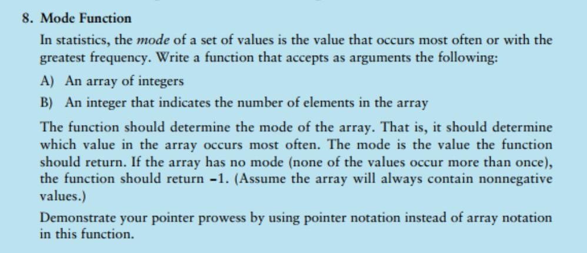

Slide 19
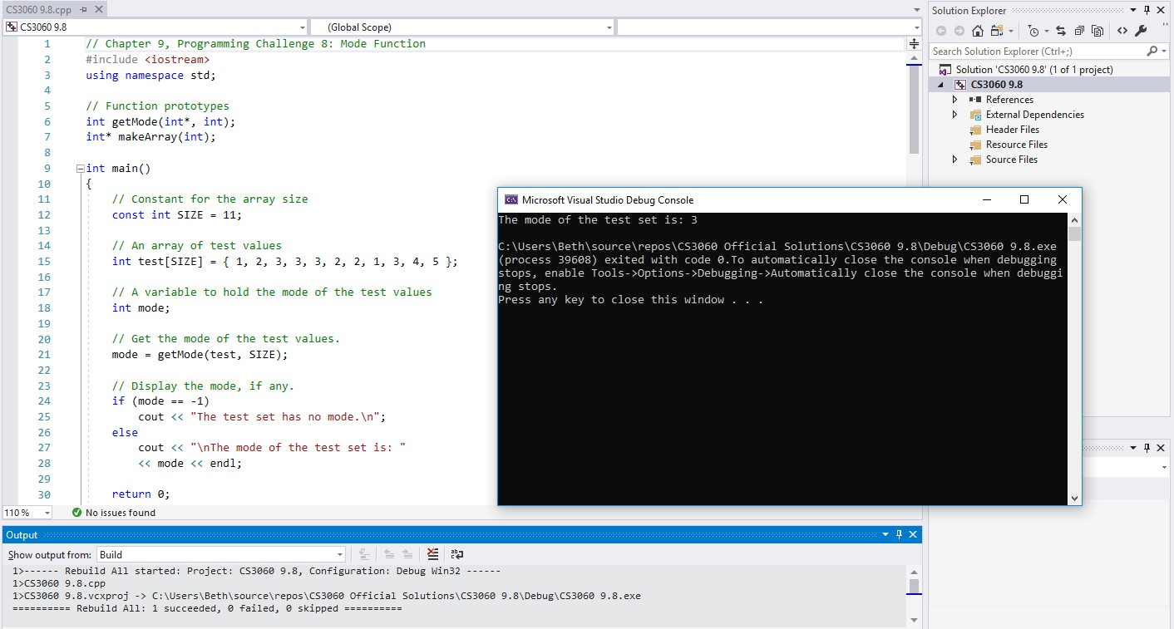

Slide 20
// Chapter 9, Programming Challenge 8: Mode Function #include <iostream>
using namespace std;
//*********************************************
// Function makeArray
// This function dynamically allocates an array of ints
// and returns a pointer to it. The size parameter is
// the number of elements to allocate.
//*********************************************
// Function prototypes
****
****
int main()
{
****
return 0;
}

Slide 21
//*********************************************
// Function makeArray
// This function dynamically allocates an array of
// ints and returns a pointer to it. The size
// parameter is the number of elements to allocate.
//*********************************************
// Chapter 9, Programming Challenge 8: Mode Function #include <iostream>
using namespace std;
// Function prototypes int getMode(int*, int); int* makeArray(int);
****
int main()
{
// Constant for the array size
****
// An array of test values
****
// A variable to hold the mode of the test values
****
// Get the mode of the test values.
****
// Display the mode, if any.
return 0;
}

Slide 22
// Chapter 9, Programming Challenge 8: Mode Function #include <iostream>
using namespace std;
//*********************************************
// Function makeArray
// This function dynamically allocates an array of
// ints and returns a pointer to it. The size
// parameter is the number of elements to allocate.
//*********************************************
// Function prototypes int getMode(int*, int); int* makeArray(int);
int* makeArray(int size)
{
int main()
{
// Constant for the array size
const int SIZE = 11;
****
}
// An array of test values
int test[SIZE] = { 1, 2, 3, 3, 3, 2, 2, 1, 3, 4, 5
};
// A variable to hold the mode of the test values int mode;
// Get the mode of the test values. mode = getMode(test, SIZE);
// Display the mode, if any.
****
return 0;
}

Slide 23
// Chapter 9, Programming Challenge 8: Mode Function #include <iostream>
using namespace std;
//*********************************************
// Function makeArray
// This function dynamically allocates an array of
// ints and returns a pointer to it. The size
// parameter is the number of elements to allocate.
//*********************************************
// Function prototypes int getMode(int*, int); int* makeArray(int);
int* makeArray(int size)
{
int* ptr = new int[size];
int main()
{
// Constant for the array size
const int SIZE = 11;
return ptr;
}
// An array of test values
int test[SIZE] = { 1, 2, 3, 3, 3, 2, 2, 1, 3, 4, 5
};
// A variable to hold the mode of the test values int mode;
// Get the mode of the test values. mode = getMode(test, SIZE);
// Display the mode, if any. if (mode == -1)
cout << "The test set has no mode.\n";
else
cout << "\nThe mode of the test set is: "
<< mode << endl;
return 0;
}

Slide 24
//*****************************************
// Function getMode
// This function returns the mode of the array pointed to
// by array. If there is no mode, itreturns -1
//**************************************************
int getMode(int* array, int size)
{
// variables
****
// Dynamically allocate an array to hold
// the frequencies of each element in the
// array. When this function ends, frequencies[0]
// will hold the frequency of the value in
// array[0], and so forth
// Store 0 in all the elements of frequencies. return mode;
}

Slide 25
//*****************************************
// Function getMode
// This function returns the mode of the array pointed to
// by array. If there is no mode, itreturns -1
//**************************************************
return mode;
}
int getMode(int* array, int size)
{
// variables
// A pointer to reference a dynamically allocated array
// to hold the frequencies of each value.
int* frequencies = nullptr;
int mode = -1;// The mode, initialized to -1
int highest = 0;// The value with highest frequency int element = 0;// To hold an element subscript int count = 0;// Loop counter
// Dynamically allocate an array to hold
// the frequencies of each element in the
// array. When this function ends, frequencies[0]
// will hold the frequency of the value in
// array[0], and so forth.
****
// Store 0 in all the elements of frequencies.
****

Slide 26
//*****************************************
// Function getMode
// This function returns the mode of the array pointed to
// by array. If there is no mode, itreturns -1
//**************************************************
// Find the frequency of each element in array.
****
int getMode(int* array, int size)
{
// variables
// Find the element with the highest frequency.
// Start by assuming the first element has the
// highest frequency.
// A pointer to reference a dynamically allocated array
// to hold the frequencies of each value. int* frequencies = nullptr;
// Step through the frequencies array and find
// the highest value.
int mode = -1;// The mode, initialized to -1
int highest = 0;// The value with highest frequency int element = 0;// To hold an element subscript int count = 0;// Loop counter
// If there is no mode (no element has a frequency
// greater than 1), then return -1. Otherwise return
// the element with the greatest frequency.
// Dynamically allocate an array to hold
// the frequencies of each element in the
// array. When this function ends, frequencies[0]
// will hold the frequency of the value in
// array[0], and so forth.
frequencies = makeArray(size);
return mode;
}
// Store 0 in all the elements of frequencies. for (count = 0; count < size; count++) frequencies[count] = 0;

Slide 27
//*****************************************
// Function getMode
// This function returns the mode of the array pointed to
// by array. If there is no mode, itreturns -1
//***********************************************
***
// Find the frequency of each element in array. for (int count1 = 0; count1 < size; count1++)
{
// The inner loop compares the array element at
// *(array + count1) with every element in the
// array. When it finds a matching element, it
// increments the element's frequency.
int getMode(int* array, int size)
{
// variables
// A pointer to reference a dynamically allocated array
// to hold the frequencies of each value. int* frequencies = nullptr;
****
}
// Find the element with the highest frequency.
// Start by assuming the first element has the
// highest frequency.
int mode = -1;// The mode, initialized to -1 int highest = 0;// The value with highest frequency
int element = 0;// To hold an element subscript
int count = 0;// Loop counter
****
// Step through the frequencies array and find
// the highest value.
// Dynamically allocate an array to hold
// the frequencies of each element in the
// array. When this function ends, frequencies[0]
// will hold the frequency of the value in
// array[0], and so forth. frequencies = makeArray(size);
// If there is no mode (no element has a frequency
// greater than 1), then return -1. Otherwise return
// the element with the greatest frequency.
return mode;
}
// Store 0 in all the elements of frequencies.
for (count = 0; count < size; count++) frequencies[count] = 0;

Slide 28
// Find the frequency of each element in array. for (int count1 = 0; count1 < size; count1++)
{
// The inner loop compares the array element at
// *(array + count1) with every element in the
// array. When it finds a matching element, it
// increments the element's frequency.
for (int count2 = 0; count2 < size; count2++)
{
if (*(array + count2) == *(array + count1)) (*(frequencies + count1))++;
}
}
// Step through the frequencies array and find
// the highest value.
****
// If there is no mode (no element has a frequency
// greater than 1), then return -1. Otherwise return
// the element with the greatest frequency.
****
return mode;
}
// Find the element with the highest frequency.
// Start by assuming the first element has the
// highest frequency. highest = *frequencies; element = 0;

Slide 29
// Find the frequency of each element in array. for (int count1 = 0; count1 < size; count1++)
{
// The inner loop compares the array element at
// *(array + count1) with every element in the
// array. When it finds a matching element, it
// increments the element's frequency.
for (int count2 = 0; count2 < size; count2++)
{
if (*(array + count2) == *(array + count1)) (*(frequencies + count1))++;
}
}
// Step through the frequencies array and find
// the highest value.
for (count = 1; count < size; count++){
if (*(frequencies + count) > highest){ highest = *(frequencies + count);
element = count;
}
}
frequencies = nullptr;
// If there is no mode (no element has a frequency
// greater than 1), then return -1. Otherwise return
// the element with the greatest frequency.
if (highest > 1){
mode = *(array + element);
}
// Find the element with the highest frequency.
// Start by assuming the first element has the
// highest frequency. highest = *frequencies; element = 0;
return mode;
}

Slide 30
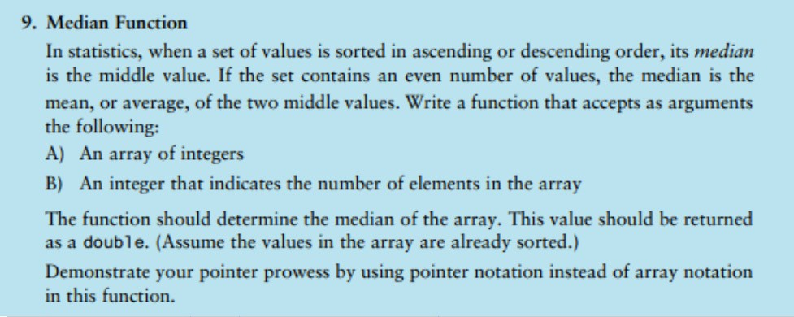

Slide 31
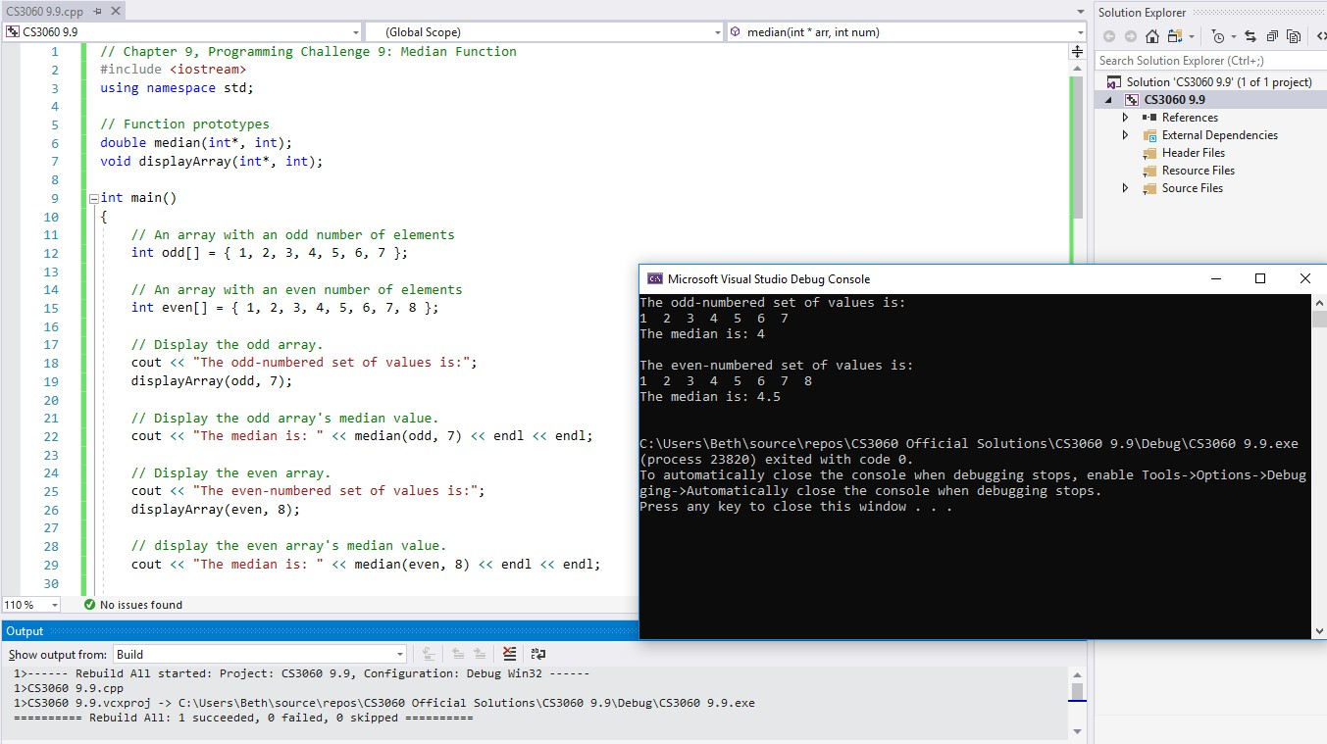

Slide 32
// Chapter 9, Programming Challenge 9: Median Function #include <iostream>
using namespace std;
// Function prototypes
****
int main()
{
// An array with an odd number of elements
// An array with an even number of elements
****
return 0;
}

Slide 33
// Chapter 9, Programming Challenge 9: Median Function #include <iostream>
using namespace std;
// Function prototypes double median(int*, int); void displayArray(int*, int);
int main()
{
// An array with an odd number of elements
****
// An array with an even number of elements
****
// Display the odd array.
// Display the odd array's median value.
// Display the even array.
// display the even array's median value. return 0;
}

Slide 34
// Chapter 9, Programming Challenge 9: Median Function #include <iostream>
using namespace std;
// Function prototypes double median(int*, int); void displayArray(int*, int);
int main()
{
// An array with an odd number of elements
int odd[] = { 1, 2, 3, 4, 5, 6, 7 };
// An array with an even number of elements int even[] = { 1, 2, 3, 4, 5, 6, 7, 8 };
// Display the odd array.
****
// Display the odd array's median value.
****
// Display the even array.
****
// display the even array's median value.
****
return 0;
}

Slide 35
// Chapter 9, Programming Challenge 9: Median Function #include <iostream>
using namespace std;
// Function prototypes double median(int*, int); void displayArray(int*, int);
int main()
{
// An array with an odd number of elements
int odd[] = { 1, 2, 3, 4, 5, 6, 7 };
// An array with an even number of elements int even[] = { 1, 2, 3, 4, 5, 6, 7, 8 };
// Display the odd array.
cout << "The odd-numbered set of values is:";
displayArray(odd, 7);
// Display the odd array's median value.
cout << "The median is: " << median(odd, 7) << endl << endl;
// Display the even array.
cout << "The even-numbered set of values is:";
displayArray(even, 8);
// display the even array's median value.
cout << "The median is: " << median(even, 8) << endl << endl;
return 0;
}

Slide 36
//**************************************************
// Function median *
//**************************************************
// Function displayArray *
// This function displays the values in the array *
// pointed to by the parameter arr. The size *
// parameter holds the number of elements in the *
// array. *
// This function displays the median of the values *
// in the array pointed to by the parameter arr. *
// The num parameter holds the number of elements *
// in the array. *
//**************************************************
//**************************************************
double median(int* arr, int num)
{
void displayArray(int* arr, int size)
{
}
****
}

Slide 37
//**************************************************
// Function median *
//**************************************************
// Function displayArray *
// This function displays the values in the array *
// pointed to by the parameter arr. The size *
// parameter holds the number of elements in the *
// array. *
// This function displays the median of the values *
// in the array pointed to by the parameter arr. *
// The num parameter holds the number of elements *
// in the array. *
//**************************************************
//**************************************************
double median(int* arr, int num)
{
double med;
void displayArray(int* arr, int size)
{
****
}
if (num % 2 == 0) // is number of elements even?
{
****
}
else
{
****
}
return med;
}

Slide 38
//**************************************************
// Function median *
//**************************************************
// Function displayArray *
// This function displays the values in the array *
// pointed to by the parameter arr. The size *
// parameter holds the number of elements in the *
// array. *
// This function displays the median of the values *
// in the array pointed to by the parameter arr. *
// The num parameter holds the number of elements *
// in the array. *
//**************************************************
//**************************************************
double median(int* arr, int num)
{
double med;
void displayArray(int* arr, int size)
{
cout << endl;
if (num % 2 == 0) // is number of elements even?
{
int mid1 = num / 2, mid2 = (num / 2) - 1; med = ((*(arr + mid1) + *(arr + mid2)) /
for (int k = 0; k < size; k++)
{
cout << arr[k] << " ";
}
2.0);
cout << endl;
}
else
{
}
med = *(arr + (num / 2));
}
return med;
}

